Slide 1



Probabilistic Programming for Dynamic Data Assimilation on an Agent-Based Model
Luke Archer, Prof. Nick Malleson, Dr. Jon Ward

Slide 2
Rapid advancements in computation power and the societal push to collect as much data as possible has led to the formation of ‘Smart Cities’
This wealth of individual level data opens up new avenues of research, with a potential to revolutionise areas of social science
One of these areas is Agent-Based Social Simulation (ABSS)
These are social simulations based on agent-based modelling, where the movement and behaviour of people can be represented at the individual level
Improving our simulations of people in Smart Cities can be used to better inform things like disaster management, and planning transport and utility infrastructure

Slide 3
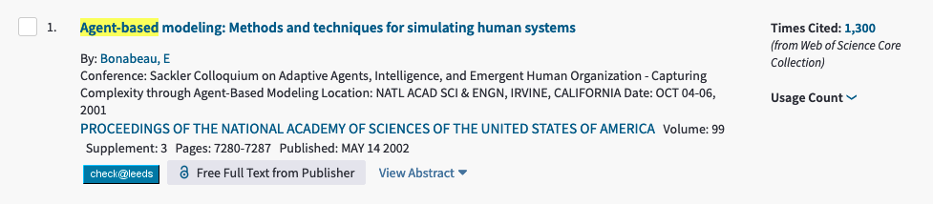
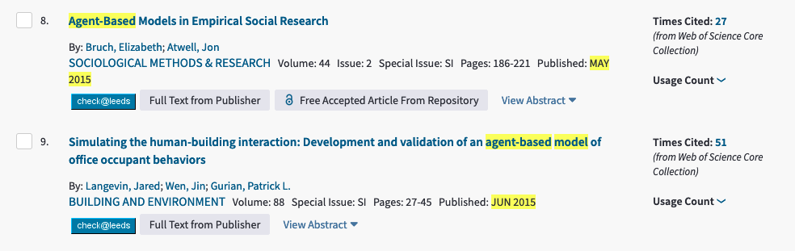
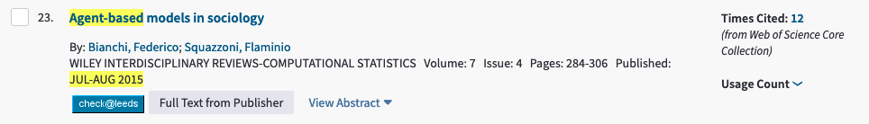
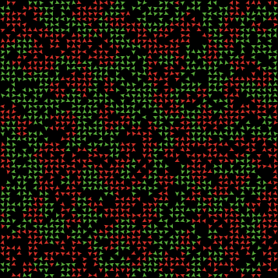
There are many examples in the literature of ABM used in social simulation
This is a well known example of an ABM - Schelling’s model of spatial segregation
Each coloured icon is an individual agent that has the ability to move a short distance each timestep
Agents in this model try to find others of the same type, and segregate themselves from their opposite colour

Slide 4
ABMs are constantly improving, partly due to the increasing amounts of high resolution data for calibration
Many new types of data are now being collected, including but not limited to…

Slide 5



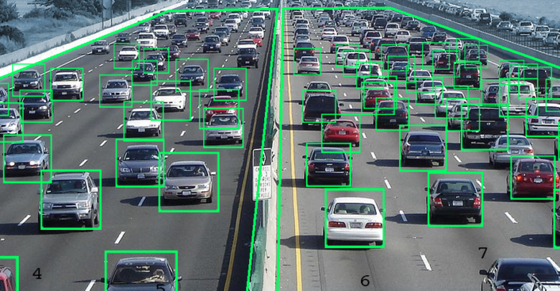
Consumer purchase data
Pedestrian sensors
Traffic sensors
Social media data
Notes:
So were producing lots more data than ever before, but it isn’t very useful to us in terms of ABMs as ABM’s have a drawback:
ABMs can only be trained once (calibrated) on historical data. This means models diverge from reality quickly over time.

Slide 6
Current methods of calibration however lead to an issue for ABMs – they can only be calibrated once using historical data (sometimes known as ‘one-shot calibration’)
This means that simulations can be created where agents act like the real-life counterparts from whom the data was collected, but no simulation can accurately model a real-world system
In order to model a system in real time, we need to find a way to update the model with new data as it is collected – in other words to stream data into the model and update its state to match the system of interest
The objective of this project therefore is to…

Slide 7
Develop a Data Assimilation algorithm on
an Agent-Based Model

Slide 8
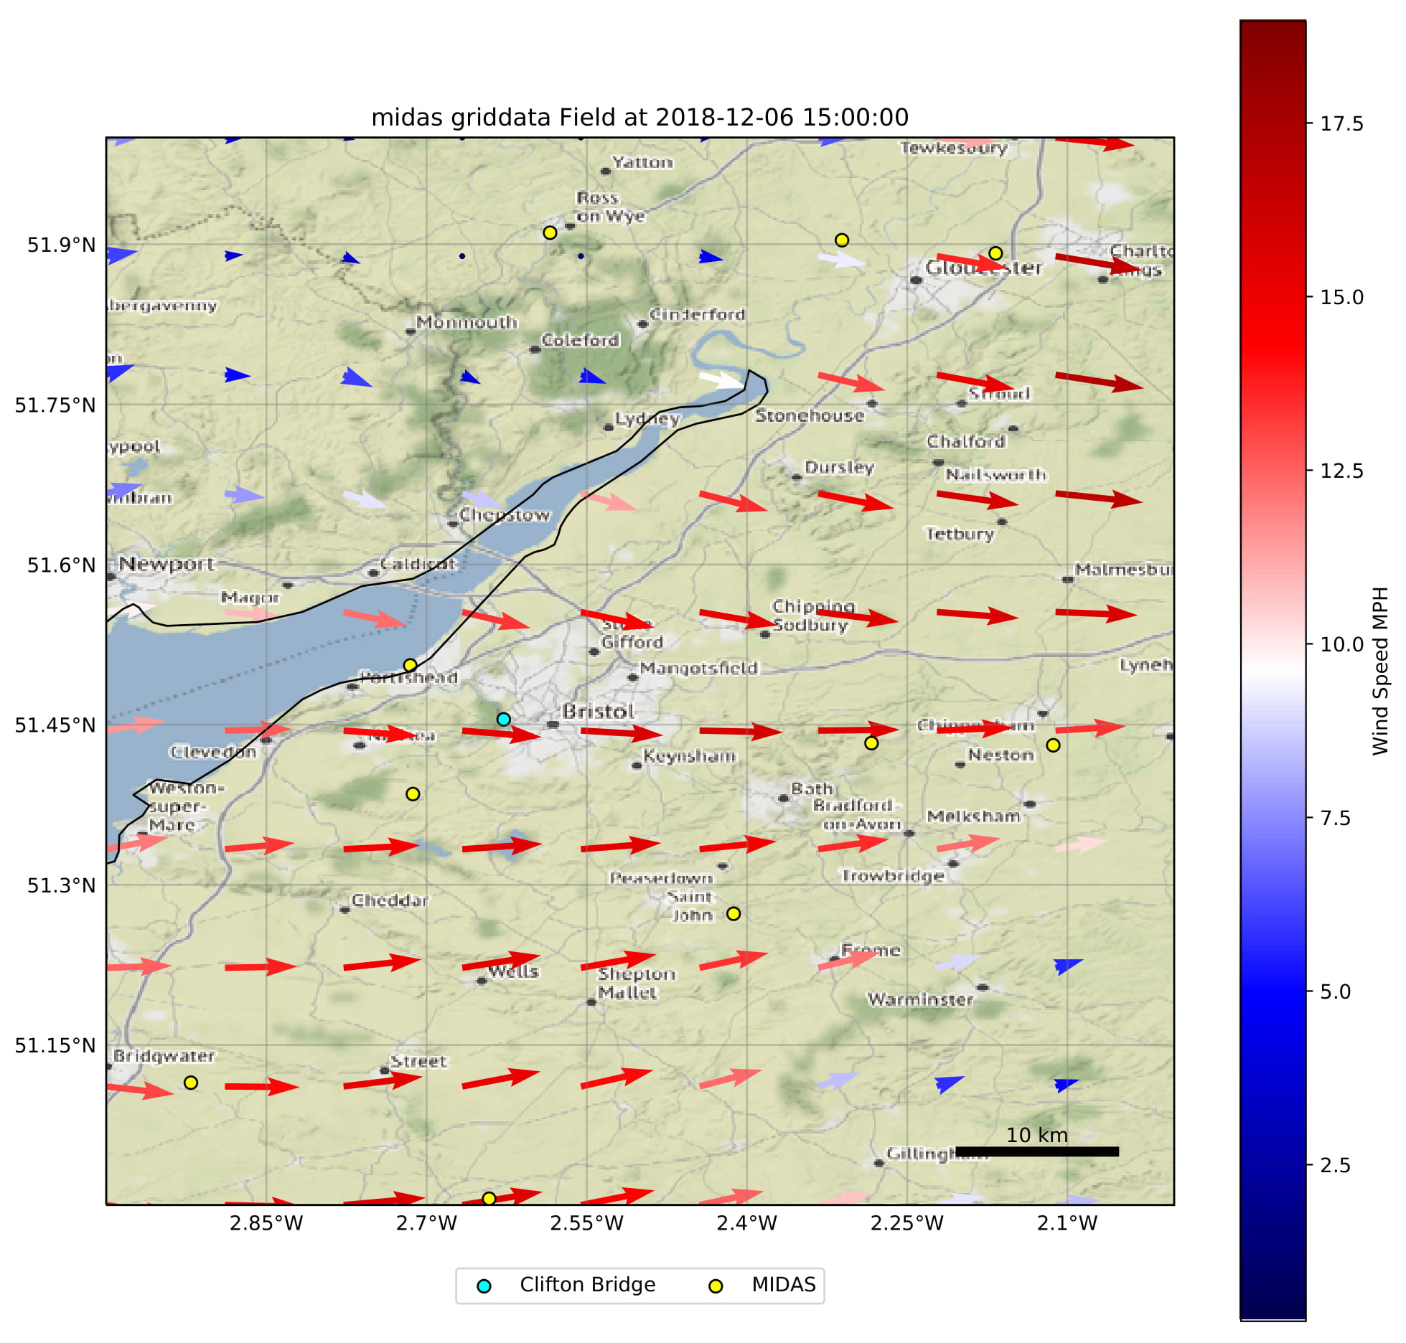
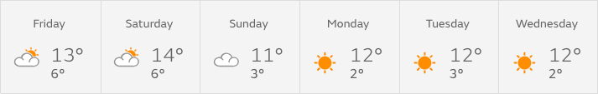
Data Assimilation is a group of statistical techniques that have been keenly developed in weather prediction
They allow for the combination of a prediction (most often from a computer model) and real-world observations, to produce a more accurate model state
~50yr
These techniques are touted as the reason for the huge improvement in weather prediction over the last ~70 years
For example, an Australian study found that current 5 day forecasts are as accurate as 1 day forecasts were 50 years ago

Slide 9
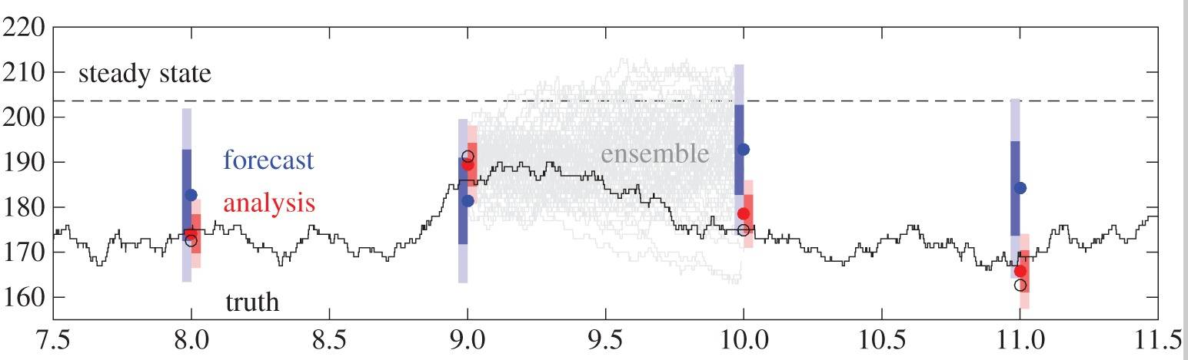
In data assimilation, a computer model produces a prediction (or forecast, blue) of a system.
Assimilation algorithms then combine the observations (analysis, red), with the forecast. The result is a more accurate state, that is closer to the true state than either the forecast or the observations.
Importantly for our objective, Data Assimilation allows the inclusion of new data in real-time with a model, and does not require the model be retrained or stopped and restarted. This makes it perfect for streaming new observations into an ABM as it runs.

Slide 10
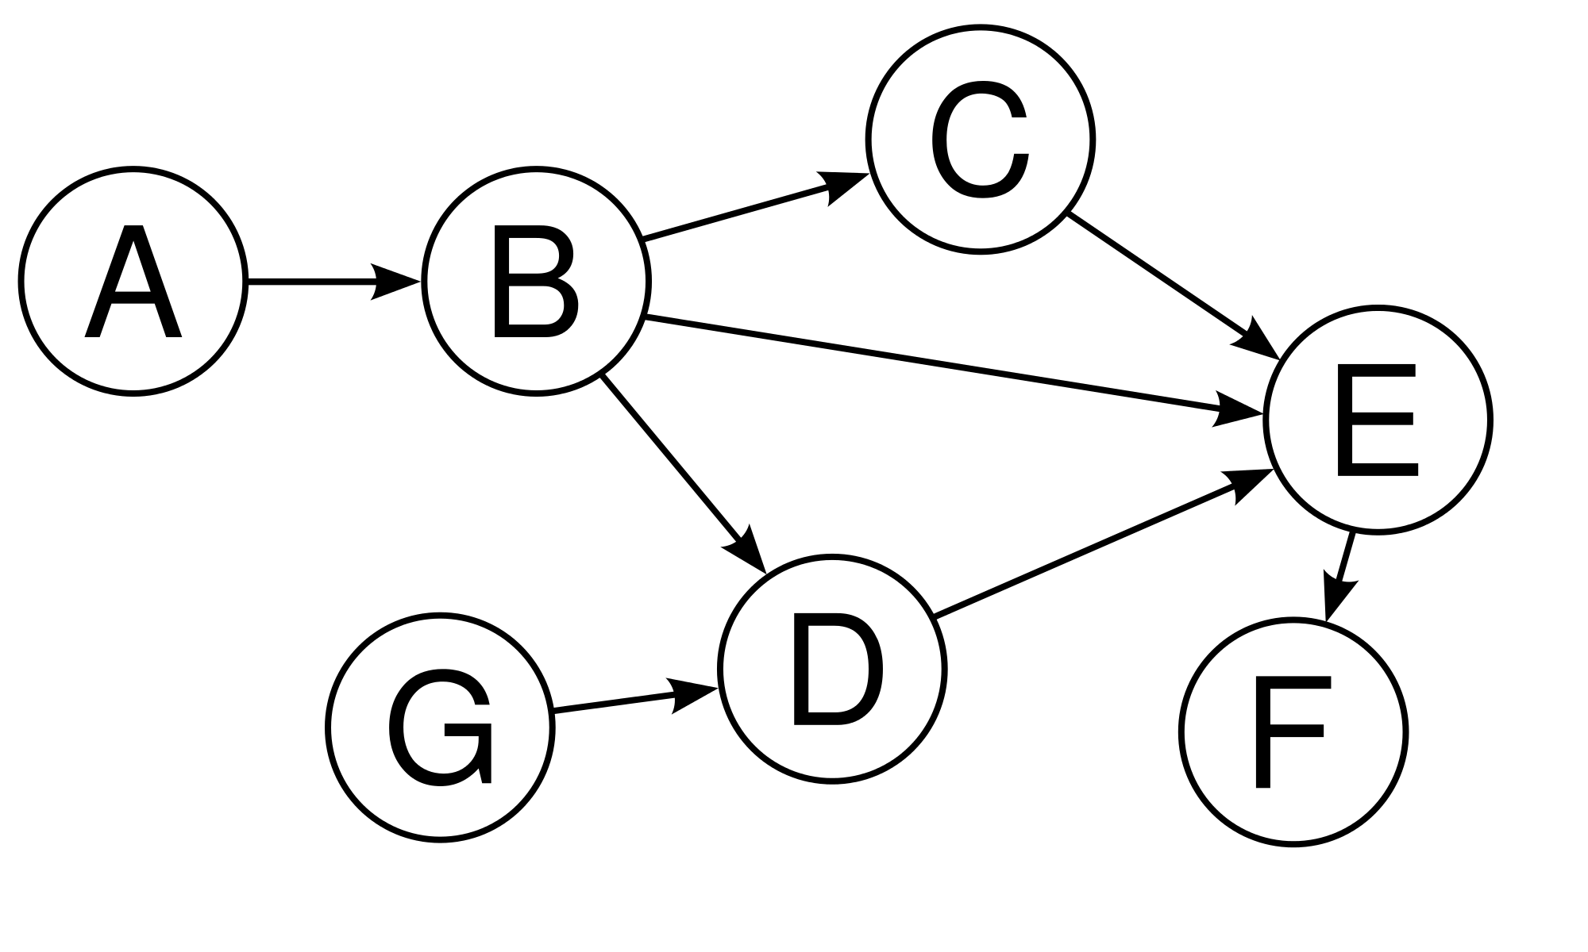
Data Assimilation is governed by a set of well studied techniques, but we have attempted to do something a bit novel. We have been working with a Probabilistic Programming library called Keanu, which is in development by Improbable Worlds Ltd., based in London.
The power of Keanu comes from the way it uses computational graphs, termed Bayesian Networks (below) in Probabilistic Programming.
Bayesian networks represent the conditional relationships between each vertex, which are the building blocks of probabilistic models.
Keanu can ‘observe’ one or multiple values in a network, setting its value and removing the uncertainty for that vertex. It then calculates the most likely value of all vertices in the network.
Using Keanu, we can represent a predictive model as a Bayesian Network, observe some true values, and Keanu will calculate the most likely value of our model state – all in real time.
Notes:
If we observe Vertex D to equal 5, what is the most likely value of all the other vertices in the network based on their CONDITIONAL RELATIONSHIP
So in this scenario, the Bayesian Network is the model that allows us to make predictions, and the data to assimilate comes from observations. Incorporating the data nudges the state towards the true value.

Slide 11
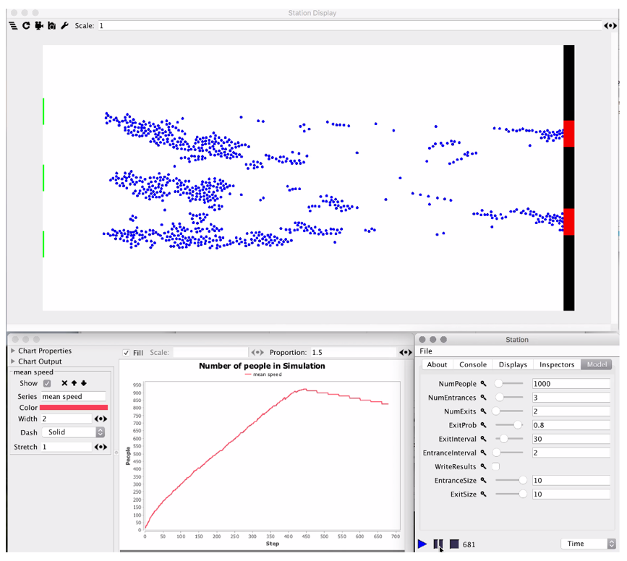
To test this new method, we have been working with an ABM affectionately known as StationSim – a very simple representation of people moving through a train station.
People (blue) move at varying speeds from green entrances on the left towards fewer red exits on the right. When a fast person gets stuck behind someone slower, they randomly move left or right to get around them. This results in some emergence – a key property of ABMs – which allows us to compare between runs.
In one cycle, we run the model once without any assimilation to collect data. The model is then run a second time, and the Bayesian Network is built to represent this run. Data from the first run is then observed at intervals (known as assimilation windows), and Keanu calculates a new model state from the prediction and observations.

Slide 12

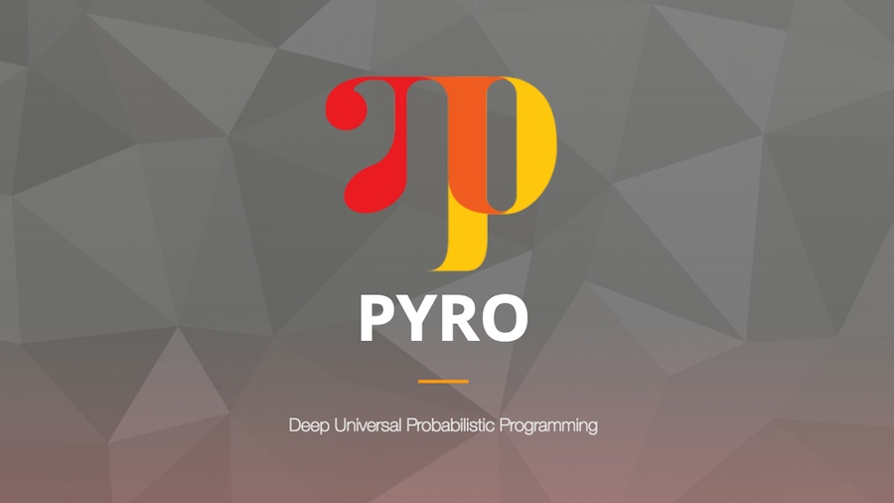
Unfortunately, we have not yet achieved good results for data assimilation in real-time. One of the main reasons behind this is how difficult it is to represent complex models accurately using Keanu. StationSim is built in MASON (a powerful agent-based modelling framework) and has a large network of complex interactions, sometimes made more complex by how MASON organises and handles these.
Due partly to these complications, StationSim will not be used in the next stage of this project. A new model is being built from scratch, to avoid complications that arose from MASON. This will reduce some complexity, particularly when trying to interface between the Probabilistic language and the model.
Keanu will also be replaced. Two potential replacements are Pyro and TensorFlow Probability, which both have excellent documentation and a large community of people using and contributing to them. This should make any challenges easier to overcome.

